Slide 1
Planning Case Studies as Quasi Experiments
Prof Maheswari S,
VIT Chennai

Slide 2
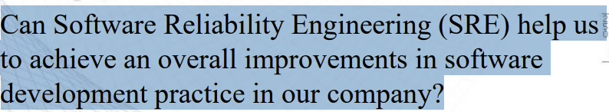
Question?

Slide 3
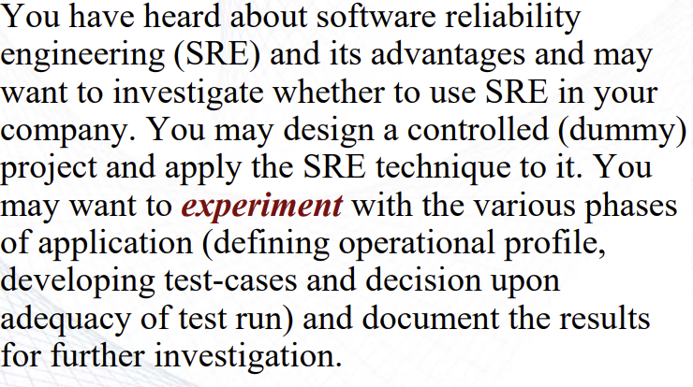
By Experiment – Research in the small

Slide 4
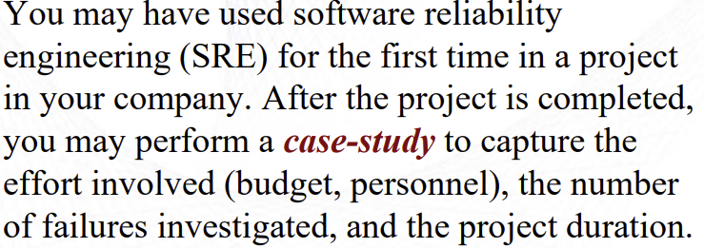
Case Study – research in the typical

Slide 5
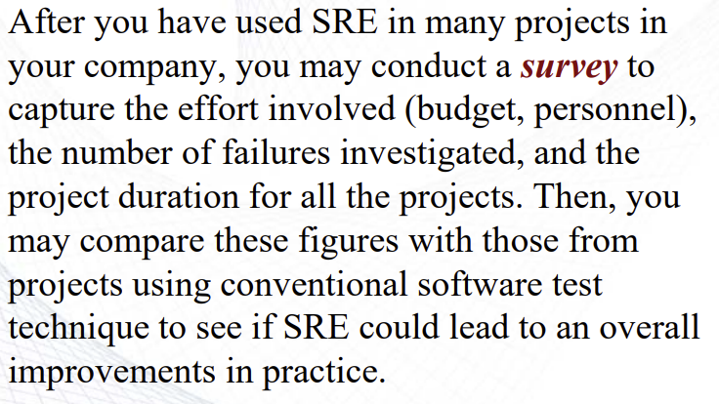
Survey – Investigate in the large

Slide 6
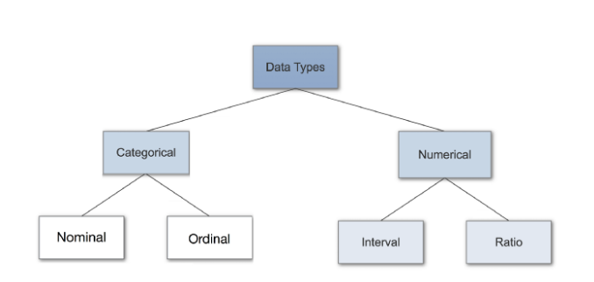
Variable Types

Slide 7
Categorical Variable
Person’s gender, language etc. Categorical data can also take on numerical values (Example: 1 for female and 0 for male).

Slide 8
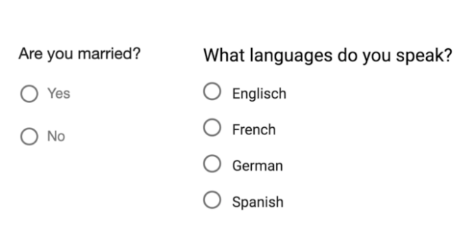
Nominal Data

Slide 9

Ordinal Data

Slide 10
Discrete Data
can’t be measured but it can be counted.

Slide 11
Continuous data
Interval
Ratio

Slide 12
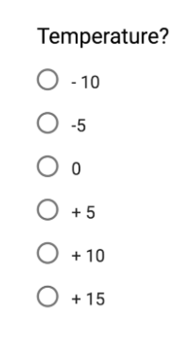
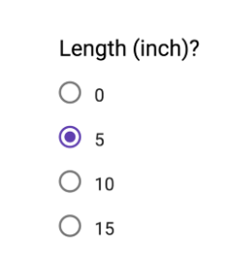
Interval Data & Ratio

Slide 13
Experiments and Quasi Experiments
An experiment is a study in which the researcher manipulates the level of some independent variable and then measures the outcome.
Experiments are powerful techniques for evaluating cause-and-effect relationships.
Many researchers consider experiments the "gold standard" against which all other research designs should be judged.
Experiments are conducted both in the laboratory and in real life situations.

Slide 14
What is Quasi Experiment?
A quasi-experiment is an empirical interventional study used to estimate the causal impact of an intervention on target population without random assignment.

Slide 15
Types of Experiments
True Experiment
Quasi Experiment

Slide 16
Quasi Experiment
The prefix quasi means “resembling.” Thus quasi-experimental research is research that resembles experimental research but is not true experimental research. Although the independent variable is manipulated, participants are not randomly assigned to conditions or orders of conditions (Cook & Campbell, 1979)

Slide 17
THANK YOU

